Slide 1
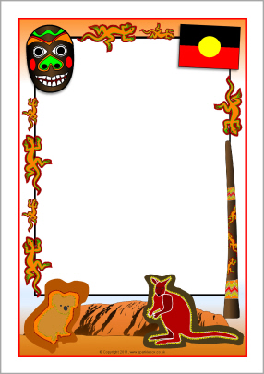
Cultural Understanding
The Early Years Learning Framework
(EYLF) describes cultural competence as…
“The ability to understand, communicate with and effectively interact with people across cultures”.
Working with young children and families means educators have a responsibility to contribute to Australia’s reconciliation and equity agendas in relation to Aboriginal and Torres Strait Islander children and families. It is important that the children attending Little Ted’s develop an appreciation and respect for diversity. As a Centre we acknowledge that diversity contributes to the richness of our society and that it is our role to embed cultural practices in our everyday program. This is achieved through many natural resources, foods, books, puzzles, shows, special visitors, oral storytelling, puppets, music and art experiences. All provide children with opportunities to reflect on other people and their ways of being
(EYLF - Principle 4).

