Slide 1
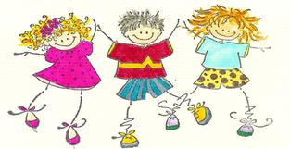
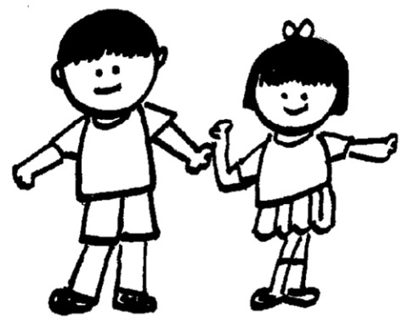
The child is made of one hundred.
The child has a hundred languages a hundred hands a hundred thoughts a hundred ways of thinking of playing, of speaking.
A hundred.
Always a hundred ways of listening of marvelling, of loving a hundred joys for singing and understanding a hundred worlds to discover a hundred worlds to invent a hundred worlds to dream.
The child has a hundred languages
(and a hundred hundred hundred more) but they steal ninety-nine.
The school and the culture separate the head from the body.
They tell the child: to think without hands to do without head to listen and not to speak to understand without joy to love and to marvel only at Easter and at Christmas.
They tell the child: to discover the world already there and of the hundred they steal ninety-nine.
They tell the child: that work and play reality and fantasy science and imagination sky and earth reason and dream are things that do not belong together.
And thus they tell the child that the hundred is not there.
The child says:
No way. The hundred is there.
-Loris Malaguzzi
Founder of the Reggio Emilia Approach

Slide 2
